Slide 1
Xpress 7.1 is all about Ultra-Large Scale Optimization
FICO Xpress Optimization Suite
Notes:
Erfahrungs/Themenbereiche (mit Kundennamen oder mehr Details zu Anwendungen?)
Kundenlogos
Transparente mit Anwendungen pro Solver nicht mehr verwenden, besser Industrie-spezifisch

Slide 2



Client References
2
© 2009 Fair Isaac Corporation. Confidential.

Slide 3




































Our Optimization Software is Everywhere
Notes:
3

Slide 4

Why American Chose Xpress
“Xpress will allow us to meet today’s challenges and will provide us with an innovative and flexible platform available for future needs.”
Armando Silva
Managing Director Operations Research
American Airlines

Slide 5
Optimization at American Airlines
Business Challenge
Optimize the operations at American Airlines
Tasks are
Plan network, fleet and facilities
(Re)Schedule flights and crew
Manage revenue
Solution
AA internal solutions based on Xpress
Notes:
Source: AA success story and AA slides for Chicago 2009 User group
At an airline
Plan network
Stations, segments, frequency and equipment type assignment
Alliances and other commercial agreements with other airlines
Relies on travel agency booking data (MIDT) and data disclosed by the DoT
Connecting traffic is very important
Plan facilities
Schedule flights
Refine frequency and equipment type
Maximize expected profit subject to constraints
Schedule crews
Staff all scheduled flights at minimum cost
Pricing
Create a competitive fare structure with different restrictions to segment the market
Control seat inventory and overbooking (a.k.a. revenue management)

Slide 6

Why Nestlé Chose Xpress
“We chose Mosel & Xpress over OPL & CPLEX because of the greater programming power that Xpress Mosel provided our Development team. This fact, plus the superior performance of the solver, made the decision very easy. With Mosel’s intuitive language constructs, an extremely fast learning curve, easier integration and a more powerful language syntax; we were able to witness an immediate impact from our Development team.”
—Clive Thomas, Manager of Nestlé Supply Chain Operations

Slide 7

Why the NFL Chose Xpress
“Scheduling the NFL season is an extremely difficult task and we need the most powerful optimization software that’s available,” says Rick Stone. Xpress outperforms other optimization tools, including CPLEX, for our sports scheduling challenges.”
—Rick Stone, President of Optimal Planning Solutions

Slide 8

National Football League
Business Challenge
Create the NFL schedule
Take into account
stadium availability
competitive impact
television schedules
Solution
Custom solution built by Optimal Planning Solutions based on Xpress

Slide 9
Case Study: Scheduling NFL Games
Challenges
  Create television schedules that best represent the league and product
  Work around stadium issues caused by other events such as concerts or baseball games
  Alleviate or minimize the competitive impact of travel schedules and/or rest days between games
  Meets specific team request for venue dates and/or opponents
  Minimizes the frequency of consecutive home (or road) games
Solution
Optimal Planning Solutions uses Xpress to create an NFL schedule to balance the needs of the fans, team, and network partners along with venue availability and weather constraints to create an optimal schedule
Results
“Countless factors, such as the need to satisfy our broadcasting partner and the need to work around stadium availability, must be taken into account when scheduling the NFL season. This process was, until recently, mostly a manual and intensely complex process. With the implementation of Optimal Planning Solutions with FICO’s MP Xpress tool, we can evaluate infinitely more scheduling options than before.” – Mike Francis, NFL Vice President of Finance, responsible for the League’s scheduling process

Slide 10
Why CAD Design Chose Xpress
“With demanding customers that include the largest semiconductor manufacturer in the world (Intel), we require optimization tools that combine robustness and accuracy with minimum solve times. After evaluating the leading optimization tools available, we found that the FICO Xpress Optimizer outperformed all of the other alternatives, including CPLEX, in our dense semiconductor application. In short, since switching away from CPLEX and moving to the FICO Xpress Optimization Suite, we couldn’t be happier.”
—Gordon Jensen, VP of CAD Design Software

Slide 11

Why Avis Chose Xpress
“Xpress was superior to Ilog. In the fixed-time scenario the results were much better, and even when we ran the longer-runtime, the results were still better. Xpress is simply a superior product.”
—Jens Utech, Director Backoffice Systems, Avis Europe

Slide 12
Case Study: Retail Space Planning and Optimization
An internationally recognized ‘Big Box’ retail chain
Challenge: Implementing a consistent merchandising process throughout its stores to maximize profitability across geography. Business users were manually creating “planograms” (shelf layouts) that resulted in sub-optimal shelf space allocation.
Solution: Drive the best use of space by enabling more precise, agile and cost-effective store merchandising decision making with FICO’s Xpress optimization engine, Blaze Advisor® business rules management system and advanced analytics modeling tools
  Predictive analytics to facilitate decisions by predicting the outcomes of action
  Decision optimization for choosing the best set of decisions among many options
  Rules for defining conditions under which decisions can be made
Results:
  Lower decision-making costs: cut merchandising decisioning costs by automating many labor-intensive elements of planogram creations.
  Improve operational efficiencies: Speeds development and deployment by automating manual processes, allowing this large retailer to create store-specific planograms
  Realize greater agility: Ability to quickly recalculate and review results of optimal set of space allocation decisions as conditions or rules are changed

Slide 13
Other areas of experience
Supply chain optimization
Portfolio generation + maintenance
Personnel scheduling
Production scheduling
Vehicle routing
Process industries (blending)
Trade optimization
Marketing optimization
Generalized assignment
(e.g. facility location)
Auctions
Airline operations
Electricity generation, supply and pricing
…

Slide 14
Very Large Scale Optimization Problems
Schedule crews for 3,400 daily flights in 40 countries
Buy ads in 10-15 local publications across 40,000 zip codes
Pick one of 742 trillion choices in creating the NFL schedule
Select 5 offers out of 1,000 for each of 25,000,000 customers
Place 1,000s of SKUs on dozens of shelves in ~2,000 stores
Decide among 200,000,000 maintenance routing options
Plan weekly production levels for several years ahead
in pursuit of Conflicting business objectives (goals)
and subject to Multiple conflicting restrictions (constraints)
Must solve (close to) optimality, or your competition will

Slide 15


Optimization Problem Structure
Decision variables (up to 100s of millions)
a.k.a. Columns
Constraints (up to 10s of millions)
a.k.a. Rows

Slide 16
Types of large MIP problems:
No discernible shape
Problems with tightly coupled rows and columns
Signature: Every decision almost directly impacts every other decision
Examples: TSP, Multi-party Exchanges, Scheduling
The bad news: Can be hard to solve, even for medium-size problems
The good news: Easy to model; Advanced solver tuning can pay off
Your best bet: Get the best solver and tune it; Identify patterns and reformulate through substitution/decomposition if possible

Slide 17
Types of large MIP problems:
Columns >> Rows
An extremely large number of columns
…
Signature: More variables than any computer’s memory could fit
Examples: Crew pairing, workforce scheduling, vehicle routing
The bad news: Implementations may have to sacrifice optimality
The good news: Parallel implementations work well in practice
Your best bet: Column generation (master problem and iterative sub-problems)

Slide 18
The key to being successful with optimization
FICO Xpress Optimization Suite 7.1
Notes:
Erfahrungs/Themenbereiche (mit Kundennamen oder mehr Details zu Anwendungen?)
Kundenlogos
Transparente mit Anwendungen pro Solver nicht mehr verwenden, besser Industrie-spezifisch

Slide 19
What you need to do …
Model the Business Problem
Solve the Optimization Problem
Solve Large and Hard Optimization Problems
Deploy the Solution
Experience and Expertise
19
© 2009 Fair Isaac Corporation. Confidential.

Slide 20
Modelling the Business Problem
Need
Design the optimization model
Implementation of the optimization model in a suitable language
Rapid development
Improving and updating the model
Visualizing results
Solution
Client Users and Experts with FICO consultants
Xpress-Mosel, a Modelling and Solving Environment and Language
Integrated Visual Development environment Xpress-IVE
Collaboration between client and FICO or external consultancy
Xpress-IVE includes graphical reports
Notes:
4-7 - jeweils die rechte Spalte dynamisch beim Durchklicken erscheinen lassen
etwas ueber "Visualization of (intermediate) results" hizufuegen

Slide 21
Modelling the Business Problem
Need
Design the optimization model
Implementation of the optimization model in a suitable language
Rapid development
Improving and updating the model
Visualizing results
Solution
Client Users and Experts with FICO consultants
Xpress-Mosel, a Modelling and Solving Environment and Language
Integrated Visual Development environment Xpress-IVE
Collaboration between client and FICO or external consultancy
Xpress-IVE includes graphical reports
Notes:
4-7 - jeweils die rechte Spalte dynamisch beim Durchklicken erscheinen lassen
etwas ueber "Visualization of (intermediate) results" hizufuegen

Slide 22
Key Features and
Benefits of Xpress-Mosel
Features | Benefits
Advanced programming languages: Algebraic modeling language Procedural programming language | Entire Mathematical Model can be stored in one place for rapid development and easy maintenance.
Utilize different solvers in the same model | From Mosel you can solve LPs, MIPs, MIQPs, Non-Linear problems, Stochastic problems, and Constraint problems
Decompose & parallelize a model to take advantage of multiple CPUs/cores | Faster solve times Make full use of your computing infrastructure through distributed computing
Build a GUI exclusively within Mosel code | Decreases development time, gets optimization in front of business user quicker
Portable across operating systems | Mosel Model compiled in one OS can be deployed on all other supported Operating Systems, decreasing development time
Open, modular architecture, User extensible | User flexibility to solve the most complicated optimization problems not limited to/by predefined language features
Compiled | Protects intellectual property
Offers a variety of APIs and data connectors | Easy deployment and works in heterogeneous environments

Slide 23
Modelling the Business Problem
Need
Design the optimization model
Implementation of the optimization model in a suitable language
Rapid development
Improving and updating the model
Visualizing results
Solution
Client Users and Experts with FICO consultants
Xpress-Mosel, a Modelling and Solving Environment and Language
Integrated Visual Development environment Xpress-IVE
Collaboration between client and FICO or external consultancy
Xpress-IVE includes graphical reports
Notes:
4-7 - jeweils die rechte Spalte dynamisch beim Durchklicken erscheinen lassen
etwas ueber "Visualization of (intermediate) results" hizufuegen

Slide 24
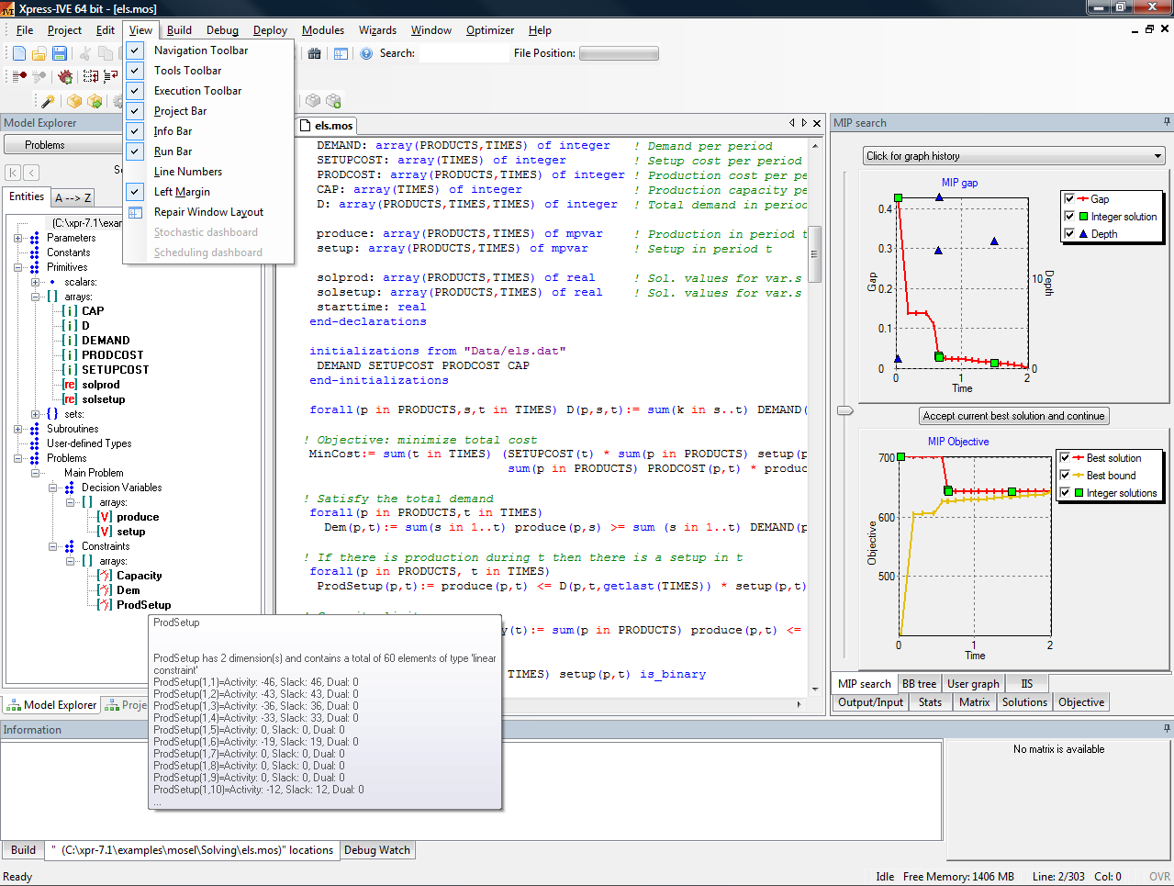
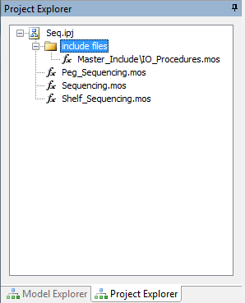
Xpress-IVE: Mosel & Optimizer
Editor
Debugger
Profiler
Progress graphs
Visualization
Wizards
Mosel extensions
Deployment

Slide 25
Modelling the Business Problem
Need
Design the optimization model
Implementation of the optimization model in a suitable language
Rapid development
Improving and updating the model
Visualizing results
Solution
Client Users and Experts with FICO consultants
Xpress-Mosel, a Modelling and Solving Environment and Language
Integrated Visual Development environment Xpress-IVE
Collaboration between client and FICO or external consultancy
Xpress-IVE includes graphical reports
Notes:
4-7 - jeweils die rechte Spalte dynamisch beim Durchklicken erscheinen lassen
etwas ueber "Visualization of (intermediate) results" hizufuegen

Slide 26
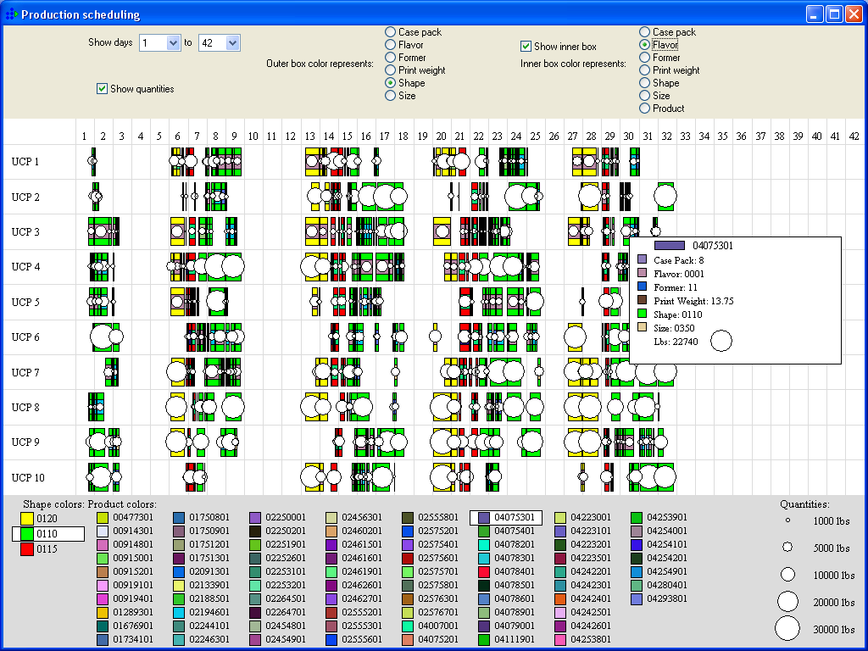
Production Planning

Slide 27
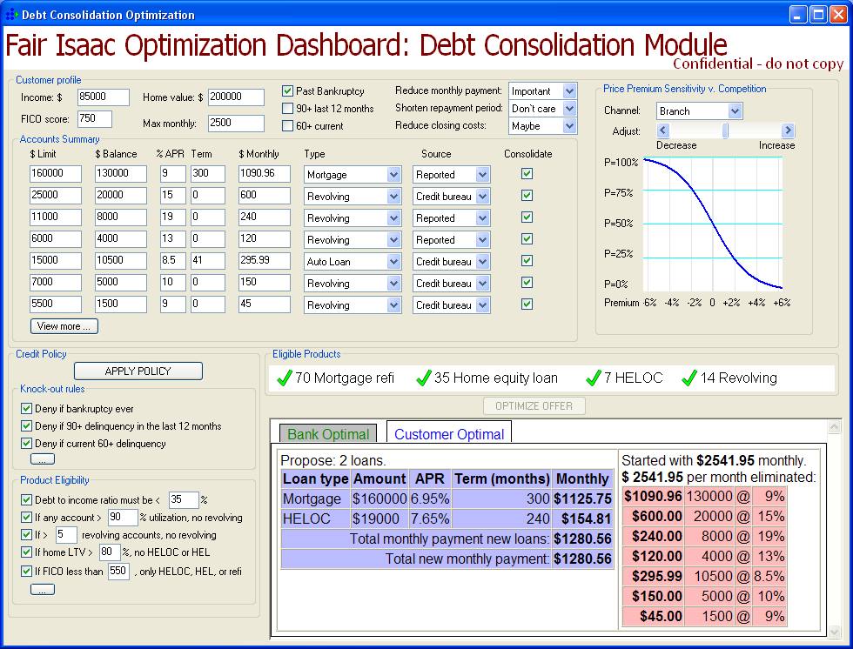
Product Portfolio & Pricing Optimization
FICO Optimization Dashboard: Debt Consolidation Module
Confidential – do not copy

Slide 28
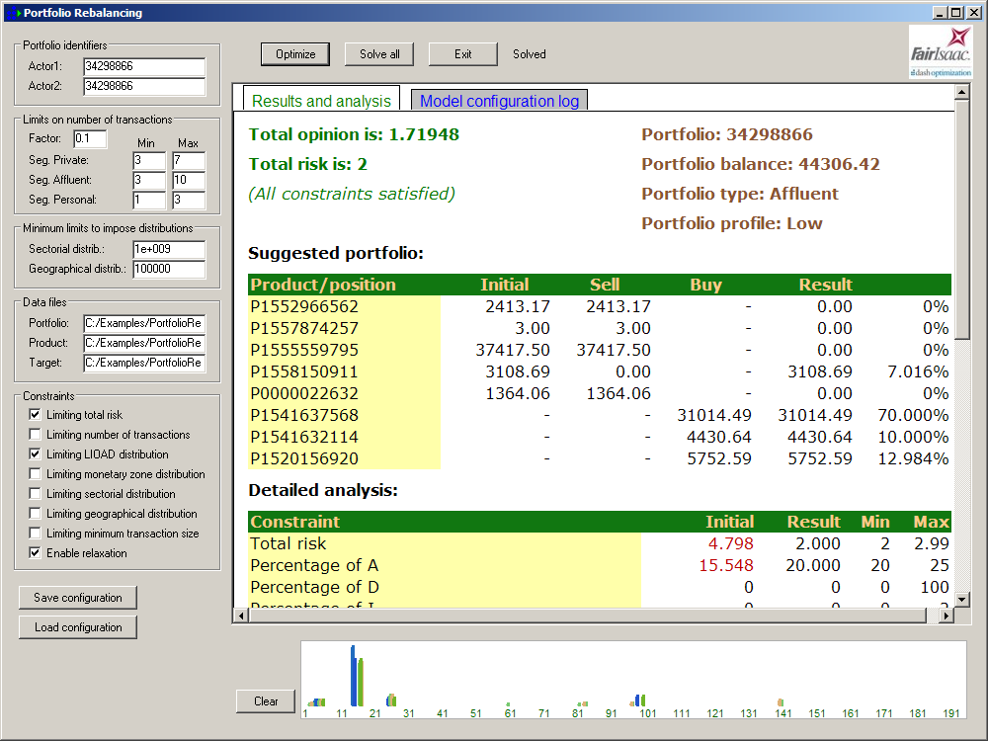

Portfolio Rebalancing Solution

Slide 29
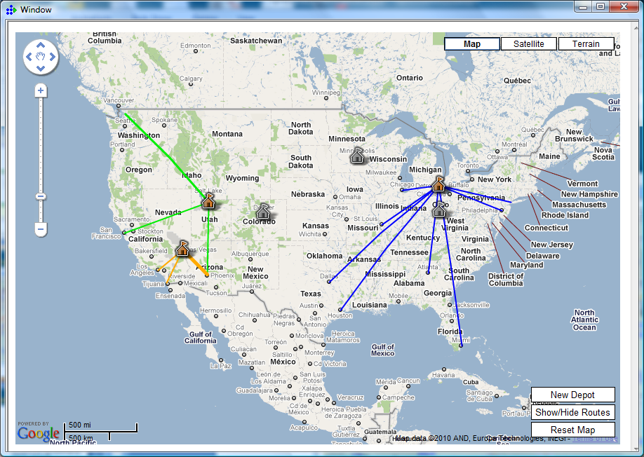
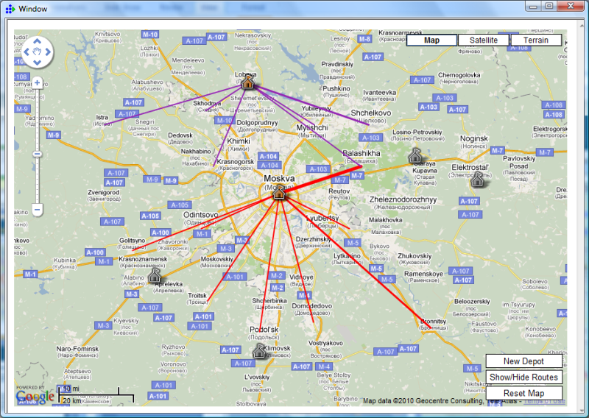
Facility Location with Google Maps integration

Slide 30
Solving the Optimization Problem
Need
The right type of optimization solver
Fast, reliable and scalable optimization engines
Tuning of the solvers for best performance
Solution
Xpress-Solvers offer a wide range of solvers
All solvers contained in Xpress are best in class with fast heuristics and high performance parallel computing
Automatic Xpress-Tuner, FICO recommendations and support from development team
Notes:
Nach dieser Folie Tuner-Screenshot-Seite oder Graphik mit Solver-Typen einfuegen

Slide 31
FICO Xpress
Offers Multiple Solvers
Solvers
MISLP
SLP
LP
MIP
GUI / studio
MIQP
LP
QP
Extensions / NI
MIP
Vertical applications
Kalis
Mosel
IVE
Modeling platform
Heuristics
XAD
User Extension
Notes:
Xpress-Mosel, modeling and programming language—Mosel can be extended by user (see circle with User Extension) also with Mosel the user can implement their own heuristics or algorithms from within Mosel
Xpress-IVE (Stands for Integrated Visual Environment) for development of mathematical models, Xpress-Mosel models are created within Xpress-IVE.
Xpress-Optimizer solves LP (stands for Linear Programming) problems, these problems have a linear objective function and linear constraints and the variables
MIP (stands for Mixed Integer Programming) add-on for Xpress-Optimizer solves problems with a linear objective function and linear constraints when the answers need to be integers (for example, you can’t schedule 1.5 people to work, the answer needs to be 1 or 2)
QP (stands for Quadratic Programming) add-on for Xpress-Optimizer solves problems with a quadratic objective function and linear constraints
SLP (stands for Sequential Linear Programming) add-on for Xpress-Optimizer solves problems with a non-linear objective function and non-linear constraints
Xpress-SP (Stands for Stochastic Programming) for mathematical modeling under uncertainty
Xpress-Kalis (Xpress-Mosel extension to use the Kalis engine for Constraint Programming. Kalis engine is developed by Artelys)

Slide 32
A Powerful Solver for Each Model Type
Solvers
MIP
MIQP
MIQCQP
MISLP
MINLP
CP
LP
QP
QCQP
SLP
NLP
Linear Programming
Capital allocation
Budgeting
Marketing, retention and cross-selling
Insurance pricing

Slide 33
A Powerful Solver for Each Model Type
Mixed Integer Programming
Collections and recovery actions
Mortgage Securitization
Credit Line Optimization
Placing Advertisements (web)
Auctions
Space optimization for retailing
Solvers
MIP
MIQP
MIQCQP
MISLP
MINLP
CP
LP
QP
QCQP
SLP
NLP

Slide 34
A Powerful Solver for Each Model Type
Mixed Integer Quadratic Programming
Portfolio rebalancing/asset management
Bundling and auctions
Solvers
MIP
MIQP
MIQCQP
MISLP
MINLP
CP
LP
QP
QCQP
SLP
NLP

Slide 35
Solving the Optimization Problem
Need
The right type of optimization solver
Fast, reliable and scalable optimization engines
Tuning of the solvers for best performance
Solution
Xpress-Solvers offer a wide range of solvers
All solvers contained in Xpress are best in class with fast heuristics and high performance parallel computing
Automatic Xpress-Tuner, FICO recommendations and support from development team
Notes:
Nach dieser Folie Tuner-Screenshot-Seite oder Graphik mit Solver-Typen einfuegen

Slide 36
MIP Performance across releases
Internal test set of 320 public and customer models
Notes:
7.1 is missing

Slide 37
Solving the Optimization Problem
Need
The right type of optimization solver
Fast, reliable and scalable optimization engines
Tuning of the solvers for best performance
Solution
Xpress-Solvers offer a wide range of solvers
All solvers contained in Xpress are best in class with fast heuristics and high performance parallel computing
Automatic Xpress-Tuner, FICO recommendations and support from development team
Notes:
Nach dieser Folie Tuner-Screenshot-Seite oder Graphik mit Solver-Typen einfuegen

Slide 38
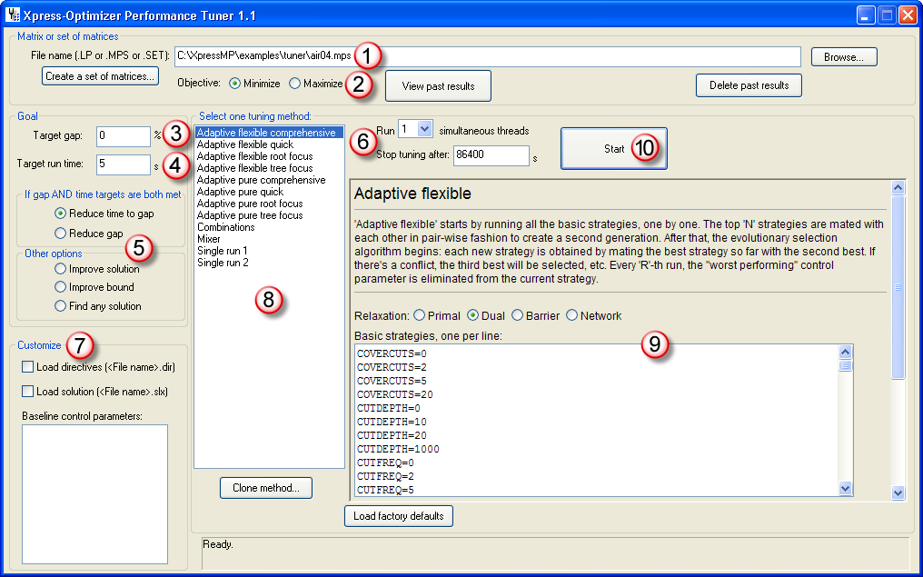
Xpress-Tuner
How to Tune (Automatically) an Optimization Problem?

Slide 39
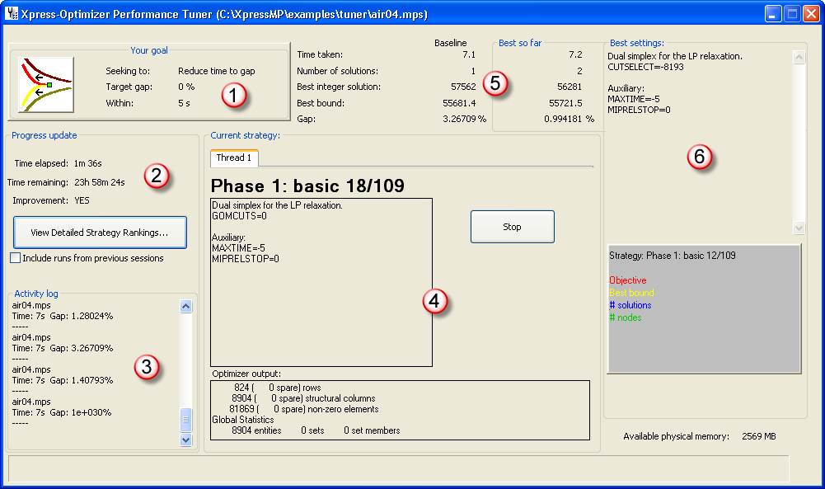
Xpress-Tuner
Tuning Process

Slide 40
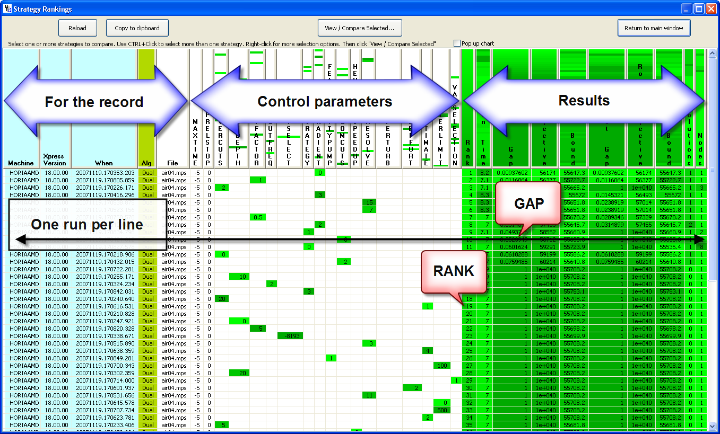
Xpress-Tuner
Detailed Results

Slide 41
Solving Hard and Large Optimization Problems
Need
Solve hard optimization problems
Solve ultra large optimization problems
Solving very hard and very large problems in short time
Solution
Xpress-Solvers are often able to solve problems that other solvers can’t solve
Xpress is first to support true 64bit for modelling and optimization
Xpress-Mosel is a full programming language with unique features for problem decomposition and distributed computing
Notes:
p6 Titel: "large-scale"

Slide 42
The MIPLIB 2003 Experience
Problem | Old Best Known Obj. Value (*) | Xpress Improved Obj. Value (**) | GAIN (|1-(**)/(*)|)
atlanta-ip | 95.009549704 | 90.00987861 | 5.3%
msc98-ip | 20980991.006 | 19839497.006 | 5.4%
protfold | -30 | -31 | 3.3%
rd-rplusc-21 | 171182 | 165395.2753 | 3.4%
sp97ar | 664565103.76 | 660705646.5 | 0.6%
stp3d | unknown | 500.736 | N/A
ds | 283.4425 | 116.59 | 58.9%
momentum3 | 370177.036 | 236426.335 | 36.1%
t1717 | 193221 | 170195 | 11.9%
liu | 1172 | 1102 | 5.9%
dano3mip | 691.2 | 687.733333 | 0.5%
Optimal
Solving Hard Mixed Integer Programming Problems with Xpress-MP:
A MIPLIB 2003 Case Study, Informs Journal on Computing, 2009
by Richard Laundy, Michael Perregaard, Gabriel Tavares, Horia Tipi, and Alkis Vazacopoulos
Unsolved

Slide 43
Solving Hard and Large Optimization Problems
Need
Solve hard optimization problems
Solve ultra large optimization problems
Solving very hard and very large problems in short time
Solution
Xpress-Solvers are often able to solve problems that other solvers can’t solve
Xpress is first to support true 64bit for modelling and optimization
Xpress-Mosel is a full programming language with unique features for problem decomposition and distributed computing
Notes:
p6 Titel: "large-scale"

Slide 44

Solvable Problem Size
True 64bit support
Solve problems with more than 2,147,483,647 non-zeros
Mount Everest from Kalapatthar, photo by Pavel Novak
Notes:
Mount Everest from Kalapatthar, photo by Pavel Novak

Slide 45
Solving Hard and Large Optimization Problems
Need
Solve hard optimization problems
Solve ultra large optimization problems
Solving very hard and very large problems in short time
Solution
Xpress-Solvers are often able to solve problems that other solvers can’t solve
Xpress is first to support true 64bit for modelling and optimization
Xpress-Mosel is a full programming language with unique features for problem decomposition and distributed computing
Notes:
p6 Titel: "large-scale"

Slide 46
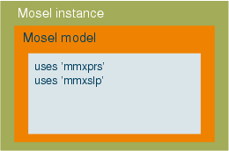
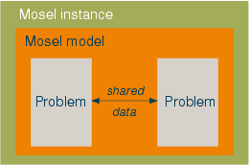
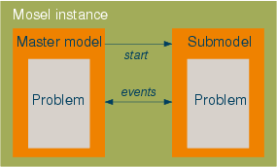
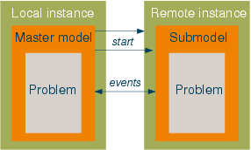
Decomposition and Distributed Modeling

Slide 47
Deploying the Solution
Need
Flexible data input and output
Seamless integration in large applications
Real time and batch processing
GUI for optimization applications
Solution
Xpress offers a range of data connectors ranging from text files to enterprise databases
Xpress offers a full set of APIs to all major programming languages, including C/C++, Java and .NET languages
Xpress runs successfully in these modes at our clients
Integrated application developer component Xpress-XAD
Notes:
nach p7 Dexia Graphik oder XAD screenshots einfuegen

Slide 48
Experience and Expertise
FICO has 50 years experience in decision management and Xpress solvers and modelling tools have been deployed for over 25 years.
FICO consultants have a proven track record at delivering high quality solutions in time.
Xpress has been used in a large number of applications across a wide range of industries.
Xpress is known for its expert consulting and support offerings.
Notes:
p8 die Formulierung "are available for over 25 years" koennte verbessert werden,
vielleicht "have been deployed in commercial applications" oder "are commercialised"

Slide 49
Xpress Optimization Suite
Deployment
GUI
XAD
Graphical user interface development using Mosel
Programming
Interfaces
.NET/Java/C/C++/VB
Solver API
Mosel API
BCL*
Development
IVE
Development Environment
IVE-XAD
GUI development
Modelling
Mosel
MOdelling and Solving Environment Language
Solvers
MIP
MIQP
MIQCQP
MISLP
MINLP
CP
LP
QP
QCQP
SLP
NLP
* Builder Component Library for modelling in a programming language
Notes:
Sollte vielleicht hinsichtlich FICO-Farbschema professionell ueberarbeitet werden
ich habe etwas Schwierigkeiten mit der Position von BCL (ist ja eher auch auf "modelling" Niveau)

Slide 50
THANK YOU

